Slide 1
AUTOMATIC LIGHT CONTROLLER-
(HOME APPLIANCES)
USING CD4017 AND IR SENSOR

Slide 2

GROUP MEMBERS
V VAISHNAVI ( 24BEC0432 )
vaishnavi.v2024@vitstudent.ac.in

Slide 3
AIM
To design and implement an automatic light control system for home appliances using CD4017 IC and IR SENSOR, enabling intelligent switching based on environmental inputs such as light intensity or occupancy.
The project seeks to demonstrate how basic digital logic can be applied to automate lighting, reduce energy consumption, and enhance user convenience without relying on microcontrollers or complex programming.
To display the output on six seven-segment displays for real-time user interaction.

Slide 4
OBJECTIVE
Design a Logic-Based Control Circuit Develop a combinational logic circuit using basic CD4017 IC to automate light switching based on input conditions like ambient light or motion detection.
Eliminate Manual Intervention Enable automatic operation of lighting systems to reduce human effort and improve convenience, especially in frequently used areas like hallways, bathrooms, or outdoor spaces.
Optimize Energy Consumption Ensure lights are activated only when necessary, minimizing electricity usage and contributing to sustainable energy practices.
Demonstrate Practical Use of Digital components Showcase how simple digital components can be used to solve real-world problems without relying on microcontrollers or software programming.

Slide 5
OBJECTIVE
Integrate Sensor Inputs Interface the integrated circuit with sensors such as LDRs (Light Dependent Resistors) or IR motion detectors to provide real-time environmental feedback. Ensure Cost-Effective Implementation Use readily available components to build a low-cost, scalable solution suitable for homes, hostels, or small offices.
Enhance System Reliability and Responsiveness Design the circuit to respond quickly and accurately to input changes, ensuring consistent performance under varying conditions.
Promote Hands-On Learning and Simulation Encourage circuit simulation using tools like Proteus or Multisim to validate logic behavior before physical prototyping.
Explore Future Extensions Lay the groundwork for integrating more advanced features like time-based control, dimming, or wireless switching using hybrid analog-digital systems.

Slide 6
COMPONENTS USED
CD4017 IC
LM358 IC
BC547 Transistor
100uF 25V Capacitor
1000uF 25V Capacitor
220-ohm 0.25watt Resistors - 4 no
10k 0.25watt Resistor
10k Trimmer
LED 5mm - 2no
IR LED pair (Detector & Emitter)
1N4007 Diode
5V SPDT Relay
Connectors & IC Base
Acrylic sheet or customised pcb

Slide 7
TOOLS USED
• Breadboard – for prototyping the circuit without soldering
• Multimeter – to measure voltage, current, and check continuity
• Soldering iron and solder wire – for permanent circuit assembly (if moving to PCB)
• Wire stripper and cutter – for preparing jumper wires and connections
• Power supply unit or battery pack – to provide regulated voltage (5V or 12V)
• Logic probe or oscilloscope – for testing logic gate outputs and signal flow
• Simulation software – like Proteus, Multisim, or LTspice for virtual testing
• PCB design software – such as TinkerCad or Eagle, if you're planning a custom board
• Schematic drawing tools – like Fritzing or EasyEDA for documentation and block diagrams

Slide 8
PCB DESIGN AND FABRICATION TOOLS
Zero PCB (Homemade Method)
Simple prototyping using printed layout on cardboard or acrylic sheet.
Single-Layer PCB Design
Makes it easy to fabricate manually or via low-cost services.
Gerber File Generation
Standard format for PCB manufacturing, compatible with most fabrication services.
JLCPCB
Used for professional PCB prototyping—affordable and supports multiple colors.
A4 Print Method
For DIY PCB:
print the layout on paper, stick it to a board, and etch manually.

Slide 9
LITERATURE REVIEW
Introduction to Motion-Based Lighting Systems Automatic lighting systems based on motion detection have gained popularity for energy conservation and convenience. These systems activate lights only when movement is detected, reducing unnecessary power usage and enhancing security. Unlike microcontroller-based designs, this approach uses discrete ICs and analog components for simplicity and cost-effectiveness.
Role of CD4017 in Sequential Control The CD4017 is a decade counter IC that responds to clock pulses and activates one of its 10 outputs sequentially. In motion-sensing applications, it receives pulses from an IR sensor and toggles the output state, effectively controlling the light. This eliminates the need for complex programming and allows for straightforward timing and control logic.
Use of LM358 as a Comparator The LM358 dual op-amp is configured as a comparator to process analog signals from the IR sensor. When motion is detected, the voltage across the IR detector changes, and the LM358 outputs a digital HIGH signal. This signal acts as a clock input for the CD4017, initiating the switching sequence.

Slide 10
LITERATURE REVIEW
BC547 Transistor and Relay Switching The BC547 NPN transistor is used to drive the relay, which controls the high-power AC load (e.g., a bulb). When the CD4017 output goes HIGH, it biases the transistor, allowing current to flow through the relay coil. A diode (1N4007) protects the transistor from back EMF generated by the relay.
Energy Efficiency and Practical Deployment Studies show that motion-activated lighting systems can reduce electricity consumption by up to 30% in residential and institutional settings. These systems are especially effective in areas with intermittent occupancy, such as staircases, corridors, and outdoor spaces.
Advantages Over Microcontroller-Based Systems While microcontrollers offer flexibility, the use of discrete components like CD4017 and LM358 provides a robust, low-cost alternative. These systems are easier to build, require no programming, and are ideal for educational and DIY applications.
Applications and Future Scope Beyond home automation, this circuit can be adapted for street lighting, washroom automation, and security lighting. Future enhancements may include integrating ambient light sensing (via LDR), adjustable delay timers, or wireless control modules.

Slide 11
FLOW CHART
1. Power ON the Circuit
The system is powered using a regulated 5V or 12V supply.
All components (IR sensor, LM358, CD4017, relay) are energized and ready to respond.
2. IR Sensor Detects Motion
The IR LED pair (emitter and detector) is positioned to monitor a specific area.
When a person or object interrupts the IR beam, the detector ’s output voltage changes.
This analog signal is the first trigger for the system.
3. LM358 Comparator Converts Signal
The analog voltage from the IR detector is fed into the LM358 op-amp configured as a comparator.
The comparator compares this voltage with a reference (set using a 10k trimmer).
If the IR signal exceeds the threshold, LM358 outputs a digital HIGH (logic 1).
This HIGH signal acts as a clock pulse for the CD4017.

Slide 12
FLOW CHART
4. CD4017 Decade Counter Responds
CD4017 receives the clock pulse and shifts its output from one pin to the next.
You can configure it so that only one specific output pin activates the light.
This output pin goes HIGH and stays HIGH until the next clock pulse (or reset).
5. BC547 Transistor Activates Relay
The HIGH output from CD4017 is fed to the base of the BC547 transistor via a 220Ω resistor.
This biases the transistor into conduction mode.
Current flows through the relay coil, activating it.
6. Relay Switches ON the Light
The relay connects the AC bulb or LED to the power source.
The light turns ON automatically when motion is detected.

Slide 13
FLOW CHART
7. Optional Delay or Reset
You can add a capacitor (e.g., 100µF or 1000µF) to introduce a delay before the light turns OFF.
Alternatively, you can use another CD4017 output pin or a manual reset to turn OFF the light after a set time.
8. System Waits for Next Motion
Once the light turns OFF, the system resets or waits for the next IR trigger.
The cycle repeats every time motion is detected.

Slide 14
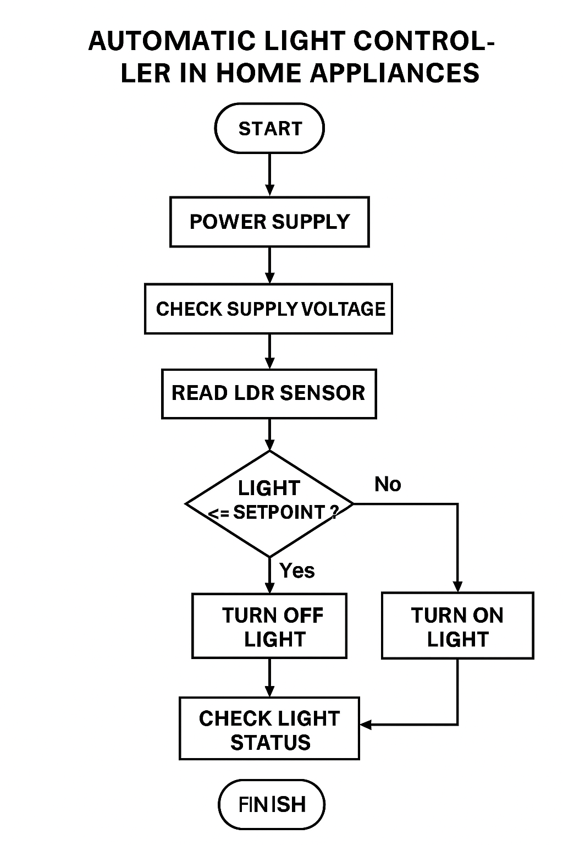
FLOW CHART

Slide 15
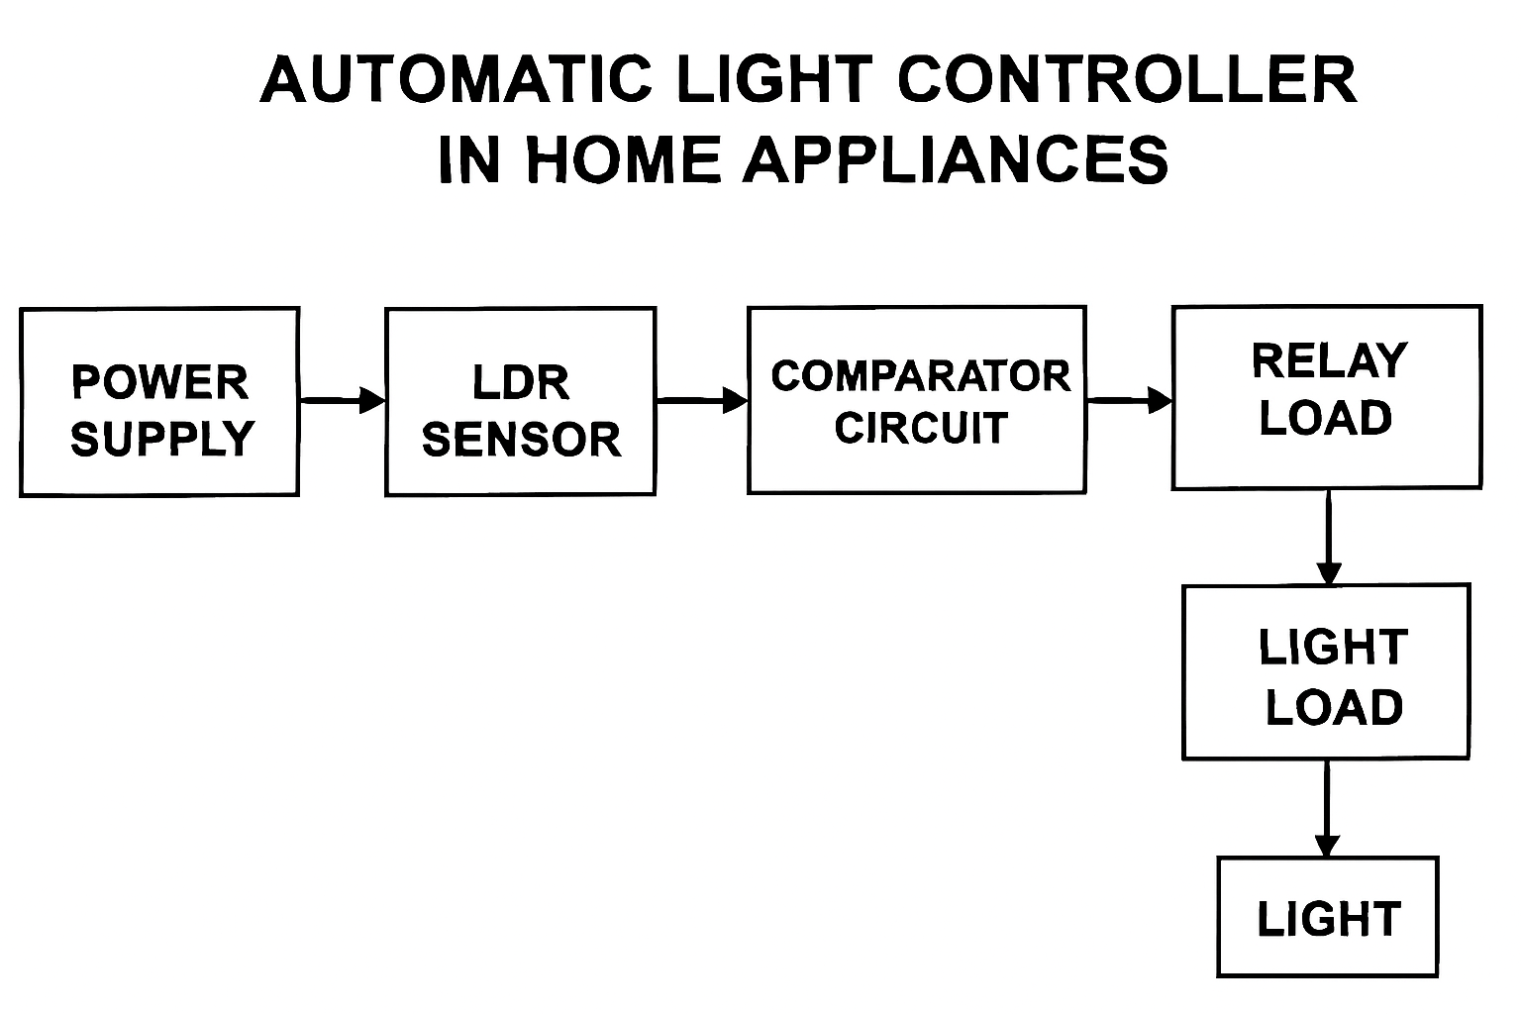
BLOCK DIAGRAM

Slide 16
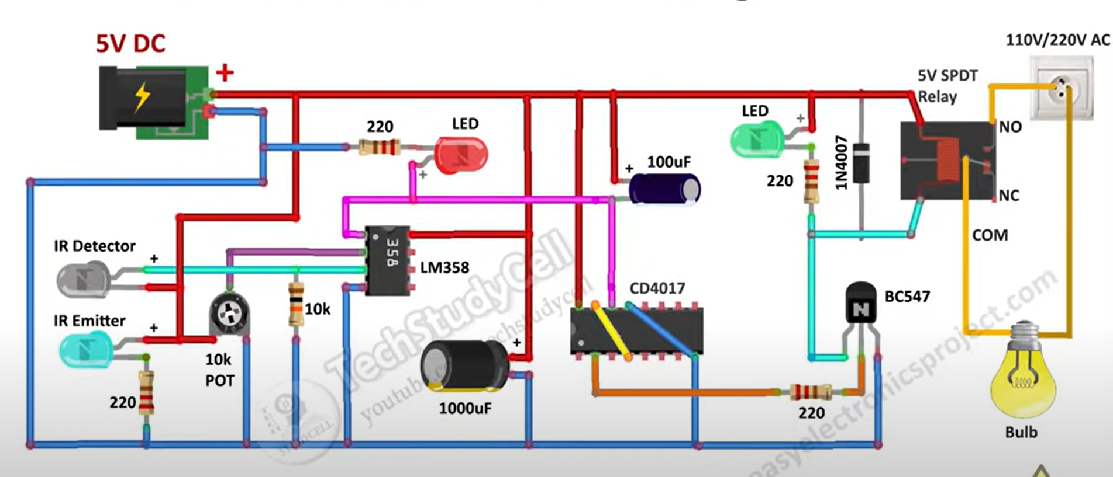
CIRCUIT DIAGRAM

Slide 17
APPLICATIONS
🏠 Residential Use
Bedroom or Living Room Lighting Automatically turns lights ON when ambient light drops below a set level (e.g., at dusk), and OFF when natural light returns.
Hallways and Staircases Ensures safe navigation by activating lights in low-light conditions without manual switching.
Bathroom Lighting Useful for night-time use—lights activate based on darkness, reducing the need to fumble for switches.
🧠 Assistive Technology
Elderly or Mobility-Impaired Users Reduces dependence on manual switches, enhancing accessibility and safety.
Child-Friendly Rooms Automatically lights up when it gets dark, offering comfort and convenience.

Slide 18
APPLICATIONS
🌱 Energy Efficiency
Smart Energy Saving Prevents lights from staying ON unnecessarily during daylight, reducing electricity bills.
Eco-Friendly Homes Integrates well with solar-powered systems or low-power LED lighting setups.
🛠️ Technical and Educational Use
DIY Home Automation Projects Ideal for students and hobbyists learning analog automation and PCB design.
Lab Demonstrations Used in electronics labs to teach sensor interfacing, comparator logic, and relay control.
🏢 Small Office or Studio Spaces
Ambient Light Regulation Maintains consistent lighting conditions for productivity or aesthetic comfort.

Slide 19
ADVANTAGES
🌙 Convenience & Comfort
Hands-Free Operation: Lights turn ON/OFF automatically based on ambient light—no need to manually flip switches.
Night-Time Assistance: Ideal for bedrooms, hallways, and bathrooms where visibility is crucial after dark.
⚡ Energy Efficiency
Reduced Power Consumption: Prevents lights from staying ON unnecessarily during daylight.
Smart Usage: Activates lighting only when needed, optimizing electricity usage.
🧠 Simplicity & Reliability
No Programming Required: Unlike microcontroller-based systems, analog controllers work without code.
Robust Design: Fewer components mean lower chances of failure and easier troubleshooting.
🛠️ Cost-Effective
Low Component Cost: Uses basic components like LDRs, op-amps, and relays—affordable and widely available.
Minimal Maintenance: Once installed, it requires little upkeep.

Slide 20
ADVANTAGES
🧪 Educational Value
Great for Learning: Helps students understand sensor interfacing, comparator logic, and relay control.
Simulation-Friendly: Easy to test in Proteus, Multisim, or breadboard setups before PCB fabrication.
🧓 Assistive Technology
Accessibility for Elderly or Disabled: Reduces dependence on manual switches, enhancing safety and independence.
🧱 Scalable Design
Modular Expansion: Can be extended to multiple rooms or zones with simple duplication.
Customizable Thresholds: Setpoint levels can be adjusted to suit different lighting needs.

Slide 21
DISADVANTAGES
Limited Precision Sensitivity depends on component tolerances; ambient light variations may cause inconsistent switching.
No Programmability Unlike microcontroller-based systems, it lacks flexibility for advanced features like timers, remote control, or adaptive thresholds.
Component Aging LDRs and relays can degrade over time, affecting performance and reliability.
Bulky for Multi-Room Use Scaling the system across multiple rooms requires duplicating the entire circuit, increasing cost and complexity.
Manual Calibration Needed Setpoint voltage for the comparator must be manually tuned, which can be tedious and environment-specific.

Slide 22
REFERENCE PAPERS
🔦 Automatic Light Control System Using LDR and Relay – IJERT IJERT, Vol. 9, Issue 5, 2020 This paper presents a simple analog system using an LDR and a relay to control lighting based on ambient light. It avoids microcontrollers and focuses on comparator-based switching—perfect for PCB implementation.
🧠 Design and Implementation of Automatic Room Light Controller Using LDR – IJARCCE IJARCCE, Vol. 5, Issue 4, 2016 Explores a comparator-based circuit using LDR to switch lights automatically. No programming or logic gates involved—ideal for analog automation in home appliances.
🏠 Automatic Room Light Controller – JETIR JETIR, March 2024 Although it includes voice control, the core system uses sensor-based switching. You can extract the LDR and relay logic for your analog-only design.
🚶 Automatic Lights Using PIR Sensor – IJARSCT IJARSCT, 2023 Focuses on motion-based lighting using PIR sensors and relays. While it mentions Arduino, the PIR-relay logic can be adapted to analog-only systems.

Slide 23
THANK YOU

